Slide 1
What do they know that we should?
Some lessons from commercial broadcasting

Slide 2




WHAT DID YOU WATCH IN 2015?

Slide 3

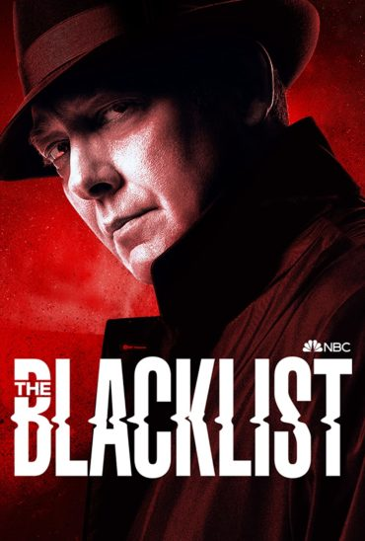
Most-watched primetime telecasts 2015
2015:
Yes, half of the Top 20 most-watched shows were sports events
  Super Bowl, 115 million viewers
  Highest entertainment show: Oscars, 38.5 million (No. 4)
But there was plenty of episodic television
  Highest scripted/recurring network show: The Blacklist, 30 million (right after the Super Bowl)
  Highest recurring in a regular slot: NCIS Jan. 6, 2015, 23.7 million
SOURCE: Variety.com
2015: https://www.tvinsider.com/62864/most-watched-tv-shows-2015-ratings/

Slide 4
Last year: How many episodic broadcasts in the Top 50?
0

Slide 5
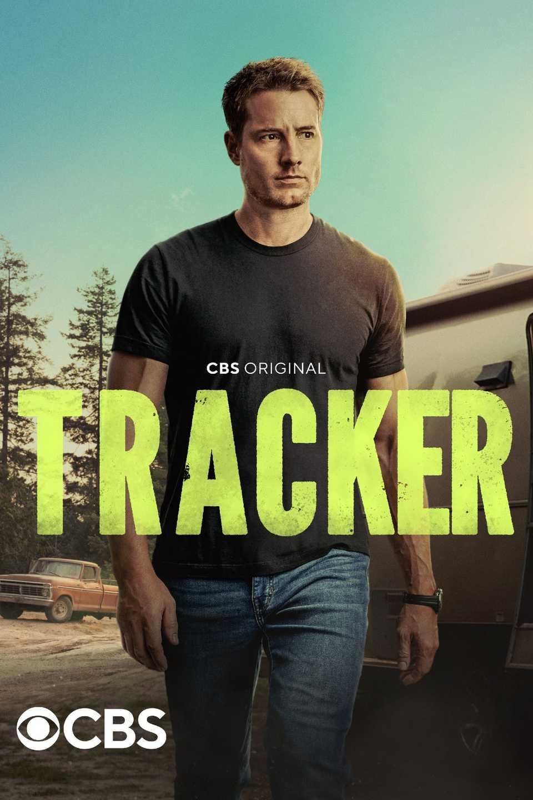
Most-watched primetime telecasts calendar 2024:
75 of Top 100 were live sports
45 NFL broadcasts
  Including 14 of the Top 15
19 Summer Olympics broadcasts
6 NBA broadcasts
Oscars (no. 13) & pres debate (no. 12)
SOURCE: Variety.com,
2024: Retrieved from: https://variety.com/2024/tv/news/most-watched-shows-2024-tracker-young-sheldon-super-bowl-olympics-oscars-1236260223/

Slide 6
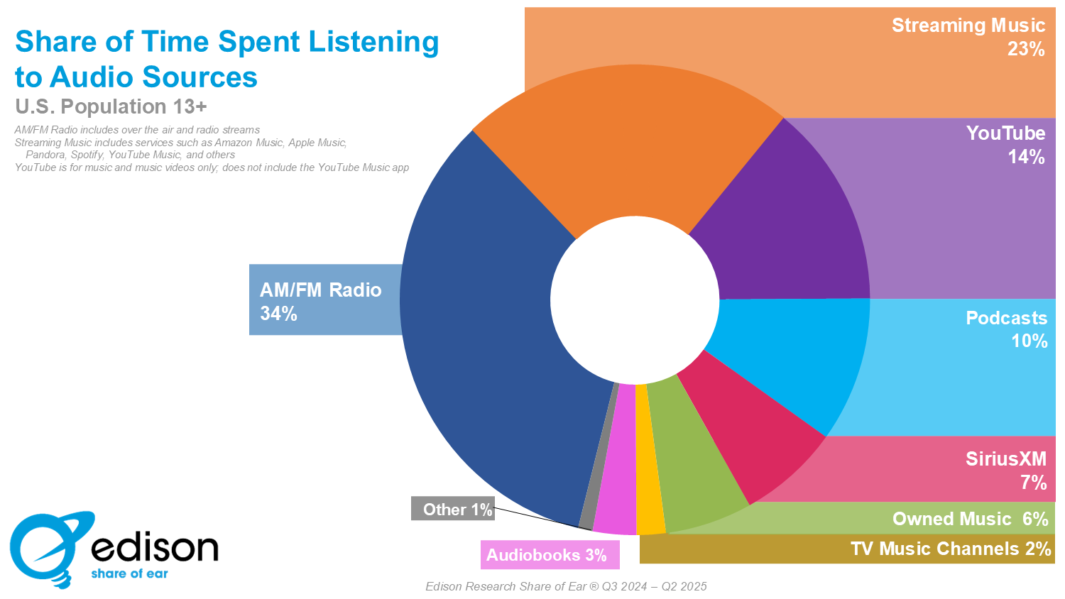
The story’s not much different in audio
Terrestrial AM/FM radio now accounts for barely one-third of consumers’ audio time
You Tube + streaming music account for more than radio!
SOURCE: Edison Research Share of Ear study, Q2 2025: https://www.edisonresearch.com/solutions/share-of-ear/

Slide 7
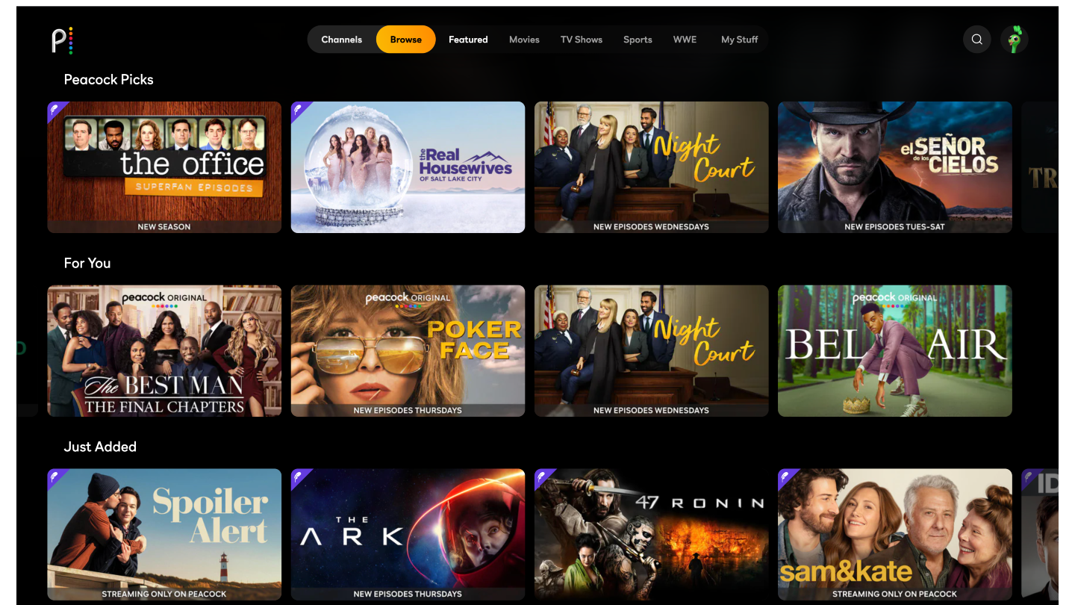

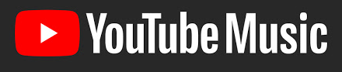

“We’re not broadcasters anymore!”
Our commercial colleagues have adapted aggressively
  Best content on streaming first …
  … and selling subscriptions, not just ads
  Even the largest radio group took the word “radio” out of its name

Slide 8

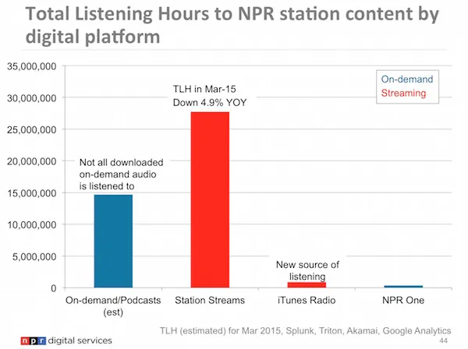
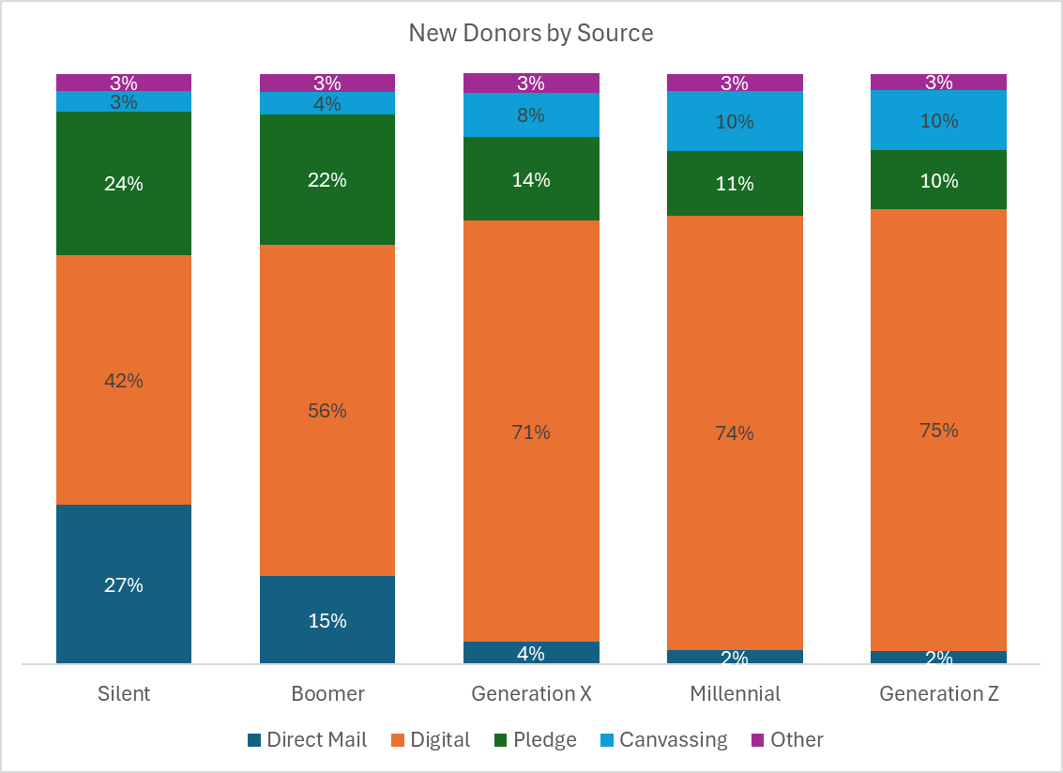
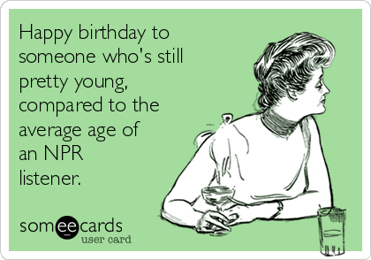
In our world?
Yeah, our content is on demand …
… and money comes in through digital channels …
BUT: Is your digital giving still tied to on-air pledge?

Slide 9
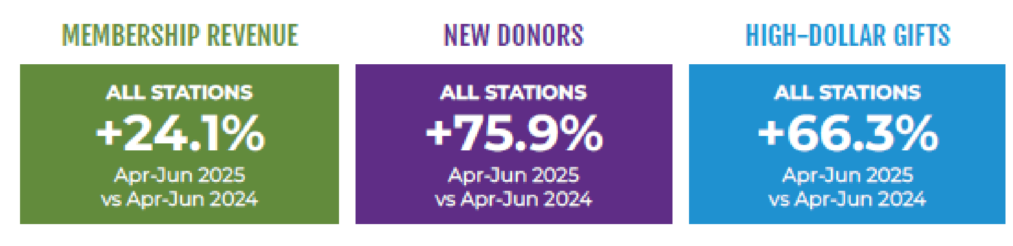
In our world:
Until the recission bump in donations …
  Raising slightly more money …
  … from slightly fewer people
We’re all grateful for the bump since the vote …
  … but will it last?

Slide 10
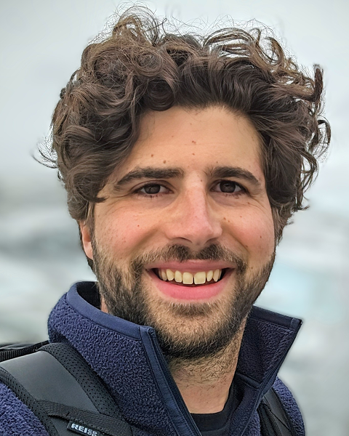
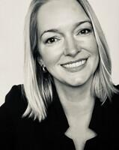
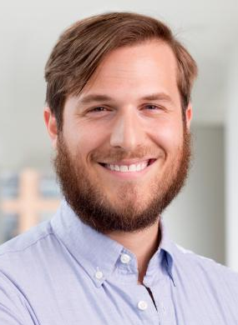
How might we get our casual followers on social platforms into our CRMs and DONOR FUNNELS?
Might we develop DIFFERENT nurturing funnels for EACH digital distribution channel?
Tyler Smith
Principal consultant
Tanager Digital
Christina McPhillips
VP, client partnerships
Carl Bloom Associates
Alex Curley
Product consultant
Semipublic.co

Slide 11

Surge to System: Growing Digital Revenue in FY26
Tyler Smith | Tanager Digital
10.23.25

Slide 12

The Real Question
Donations are surging in 2025 due to political attention on public media funding
But what happens in FY26 when this normalizes?
The answer: Digitize fundraising or watch revenue decline back down
—
What happens next?

Slide 13
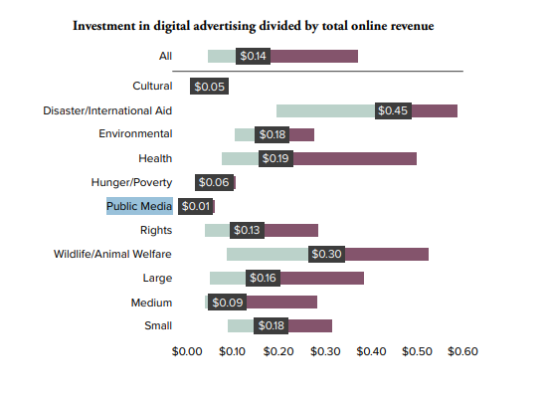
The Investment Reality
—
The Investment Gap Creates the Opportunity Gap

Slide 14
The Organic Reach Problem
What % of your Facebook followers see your median post? (Typically <2%)
What's your email click-through rate? (Typically 2-5%)
How many monthly searches for your station actually convert to donations? (<1%...)
👉Simply posting occasionally and sending a weekly newsletter isn't enough
—
Verify for Yourself!

Slide 15
What Commercial Media Knows
✔️They invest in digital distribution to reach audiences where they actually are
✔️They use always-on campaigns, not just seasonal pushes
✔️They use modern tech (algorithmic targeting) vs. manual, outdated work (donor files)
👉Tom showed us they followed their audience to streaming (to social media, to Google, etc). This is the fundraising imperative.
—
What Do They Do That We Don't?

Slide 16
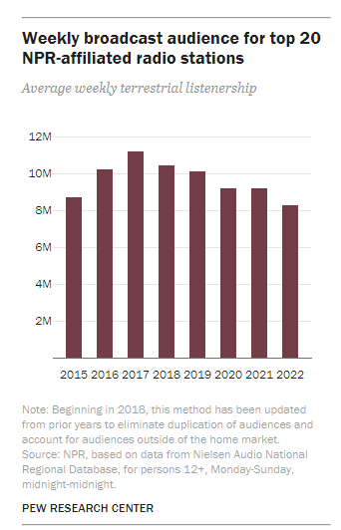
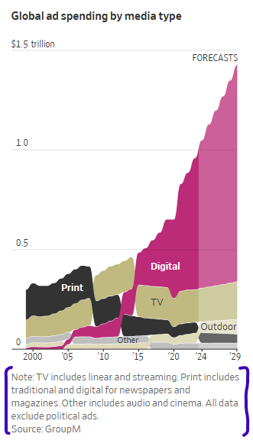

Slide 17
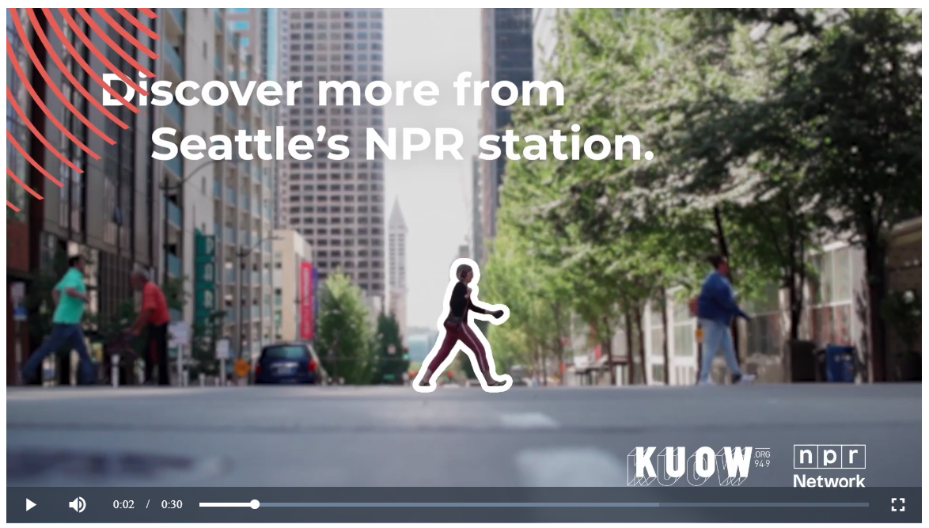

Slide 18
Spring ‘25 (FY25)
Streaming Investment (CTV)
—
Investment: $12,051
Households: 136,961
Verified Visits: 20,780
Avg. Cost: $0.09/hh
Summer - Fall ‘25 (FY26)
Rescission + Fall Drive
—
-$6,379 raised attributable to CTV
-55% recovered immediately despite non-clickable format
-More touchpoints = faster donation cycles (5 years > 5 weeks)

Slide 19
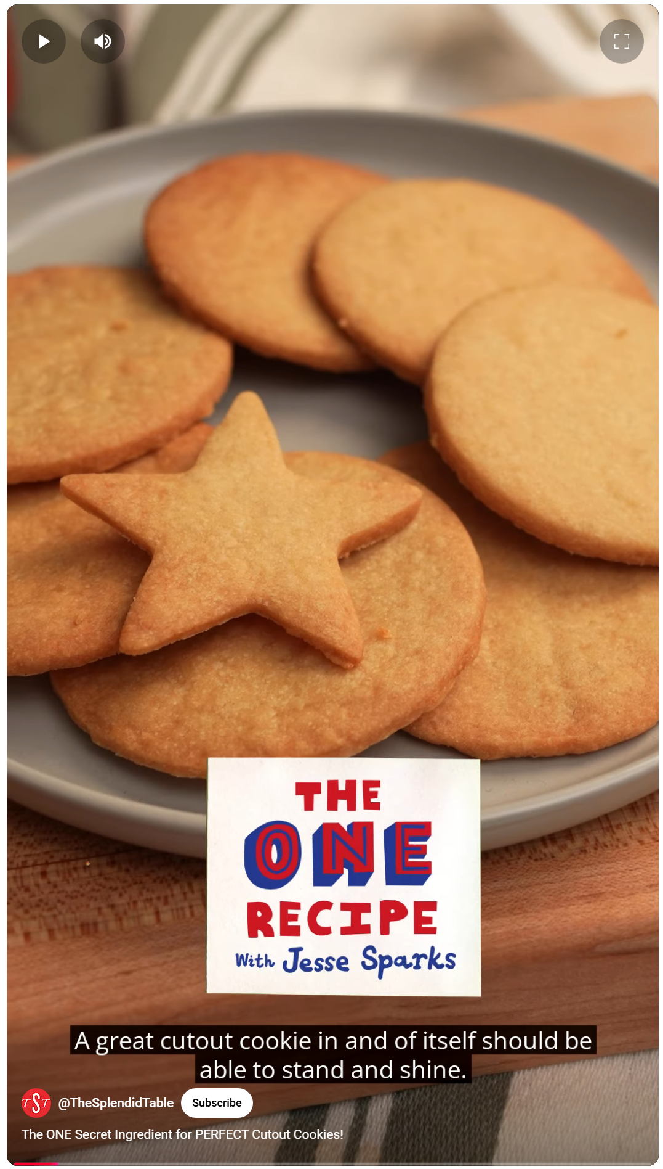
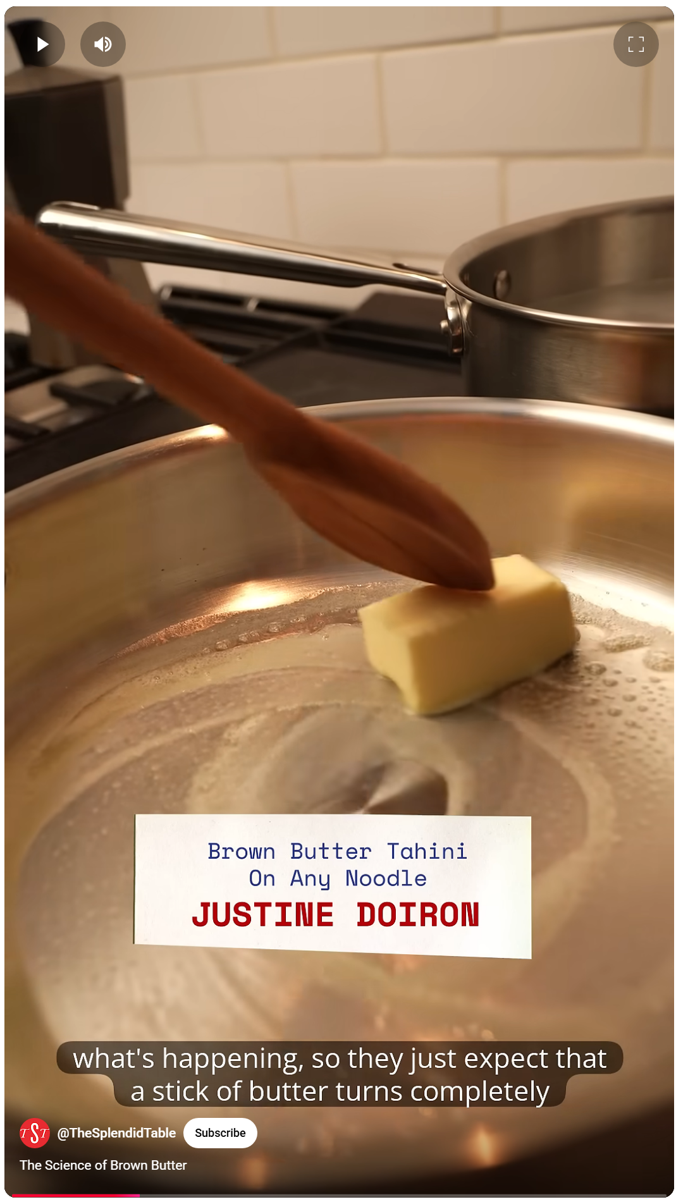
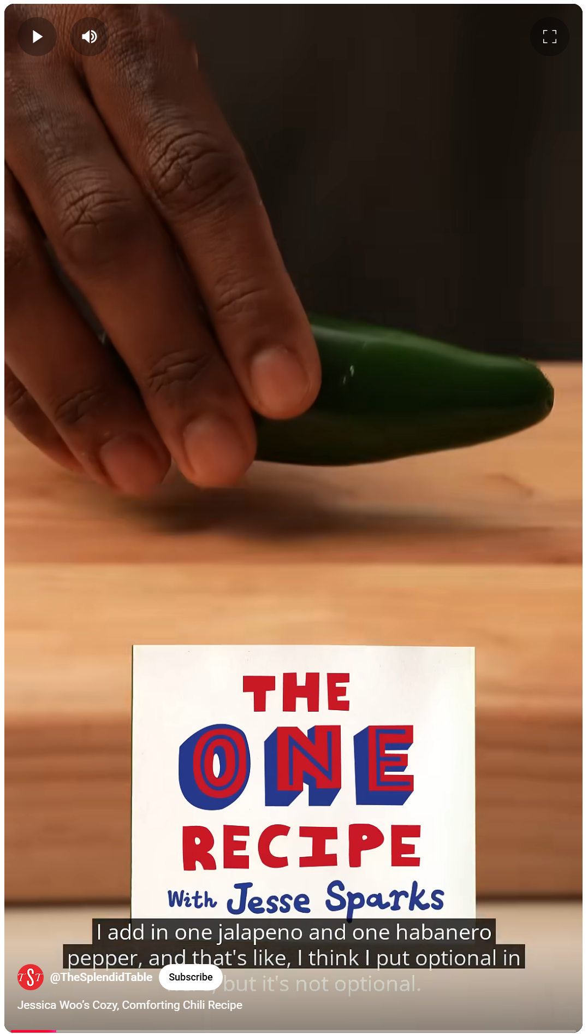

Slide 20
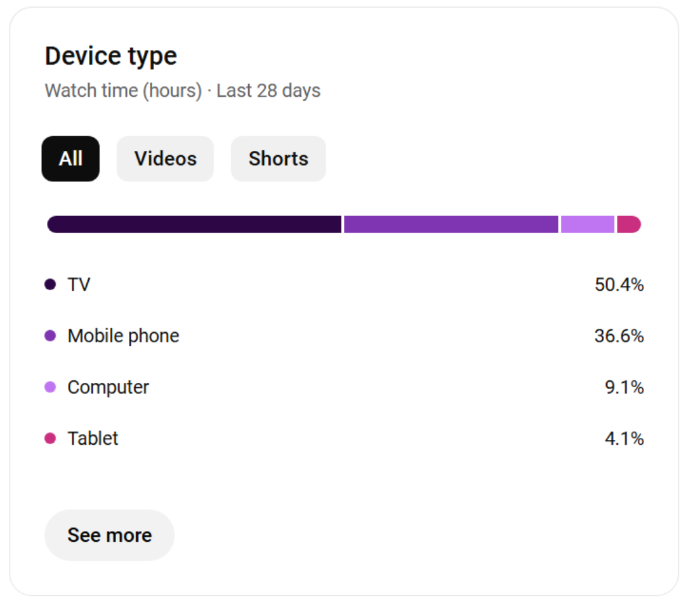
APM Studios saw a residual, organic increase of ~3,500 viewers (10.4k expected monthly avg. vs. 13.9k actual)
  34% residual lift in organic viewership

Slide 21
Modern Donor ID
A $500 investment in an algorithmically-targeted Meta ad:
  70,300 people reached
  32% engaged / 8% clicked link
  $4.86 CPM (to reach 1k prospects)
Those who click and stay engaged ARE your prospective donors (to then nurture!)
👉This tells stations EXACTLY who their donors are - not abstract third-party data from thousands of miles away
Can scale down to $50 for smaller markets
—
The $50 Test That Identifies Your New Donors (and starts the conversation)

Slide 22
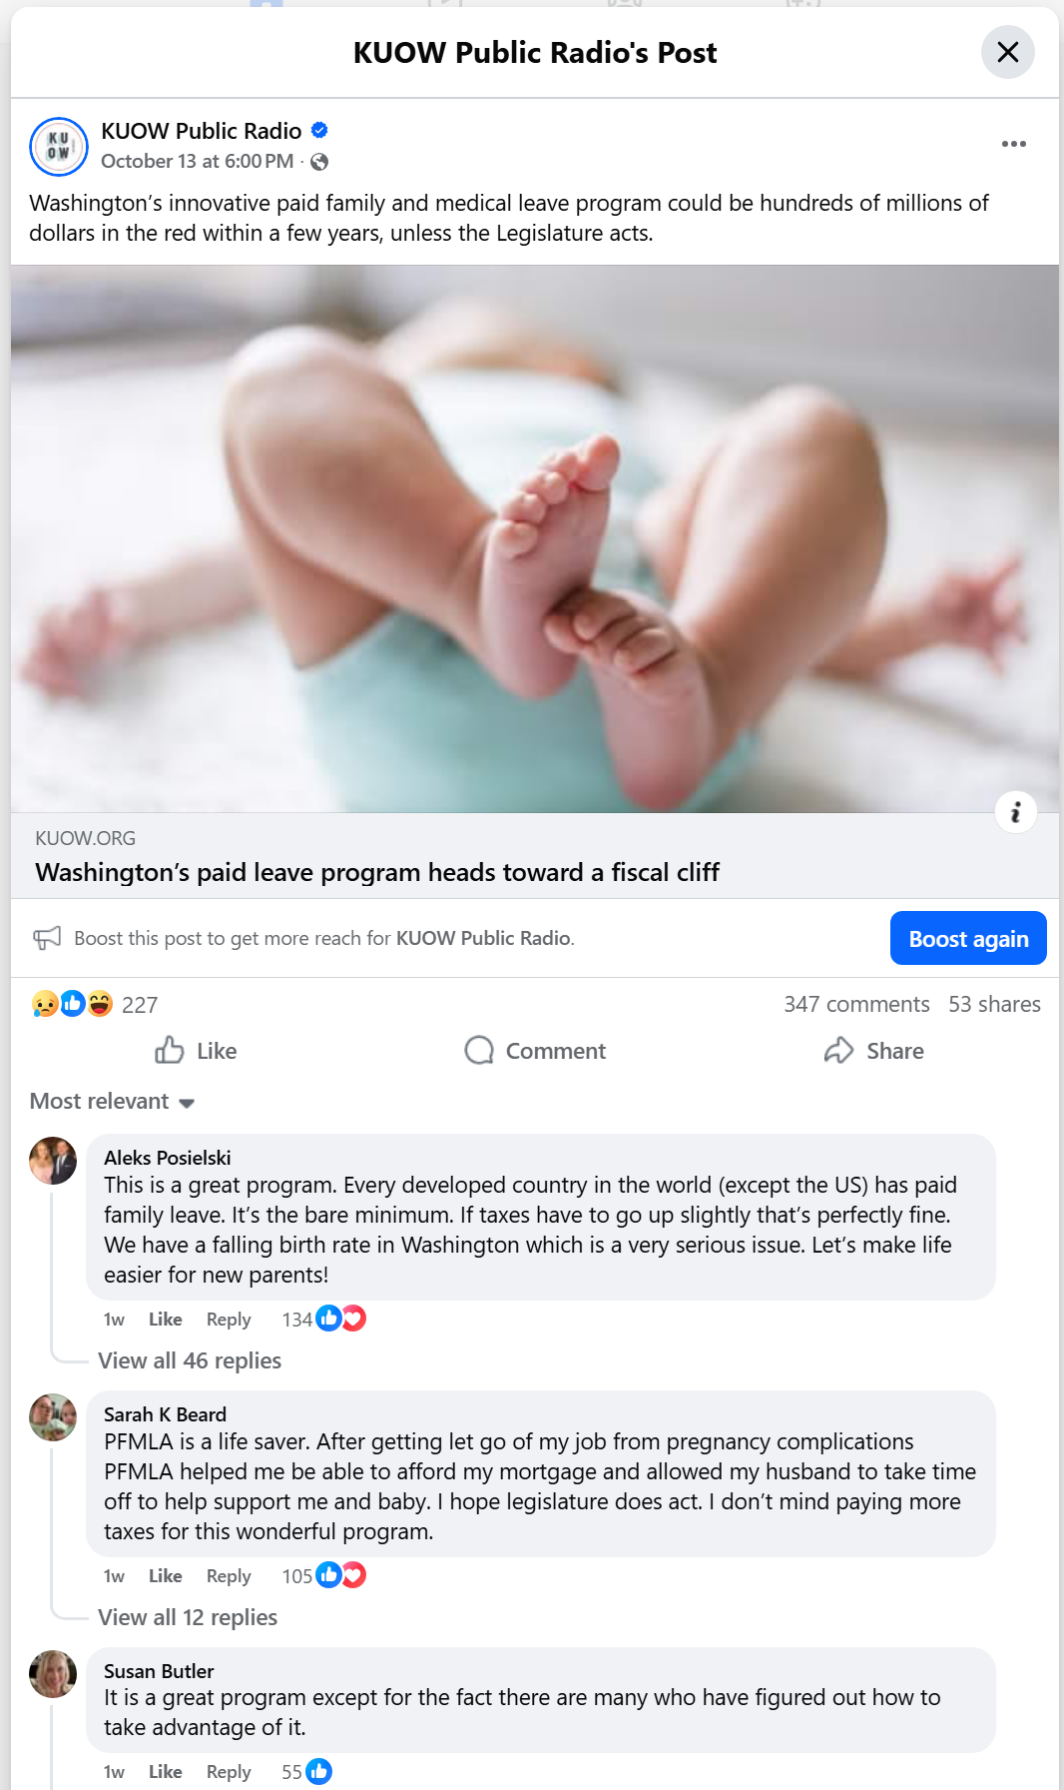
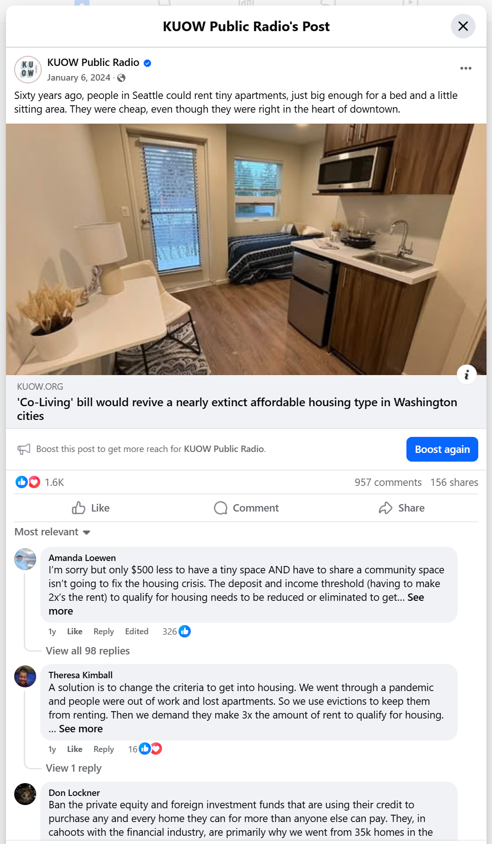

Slide 23
Distribution + Nurture System
1. Automate Distribution
↓ Content ads promoting local news
↓ Start conversations →
2. Stay Present with Always-On
↓ Brand ads to engaged audiences
↓ Retargeting, Meta engagers, lapsed donors, prospects →
3. Invest Acutely During Drives
↓ Paid search when intent is highest
↓ Conversion
—
Building the Pathway to New Donors

Slide 24
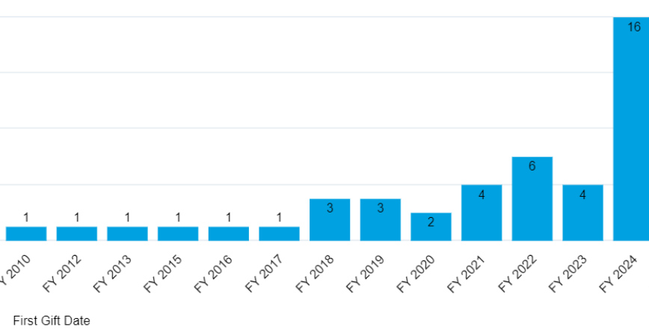

Slide 25
Development Operations
❌Traditional Model
Marketing measures impressions
Membership measures gifts
Nobody measures revenue
✅Development Operations (DevOps) Model
One team → One budget → One KPI: Revenue
Economies of scale
Efficient resource use
👉Private sector has Chief Revenue Officers overseeing marketing + sales. Public media needs VP Development leading both marketing and membership with shared goals.
—
Learning from Private Sector

Slide 26
Everyone Lives Online
Every donor, big to small…
…has a Facebook or Instagram profile📱
…uses a Google account🔍
…streams content regularly📺
…lives a digital life where ad experiences are innately normalized 💻
Mission-driven content stands out against swimwear ads!
—
From Tip-Level Donors to Major Givers…and Everyone In-between

Slide 27
Key Takeaways
Invest to be discovered - You're systematically under-investing vs other nonprofits
More digital touchpoints = faster time to donation - Collapse 3-5 years to months
Modern tech reveals your actual donor pool - Pennies and minutes vs thousand-mile donor files
Must invest to meet audience where they are - Distribution isn't free in the digital world
Organizational alignment multiplies results - Unified operations = efficiency
—
The Answer to 'What Do We Do in FY26?

Slide 28
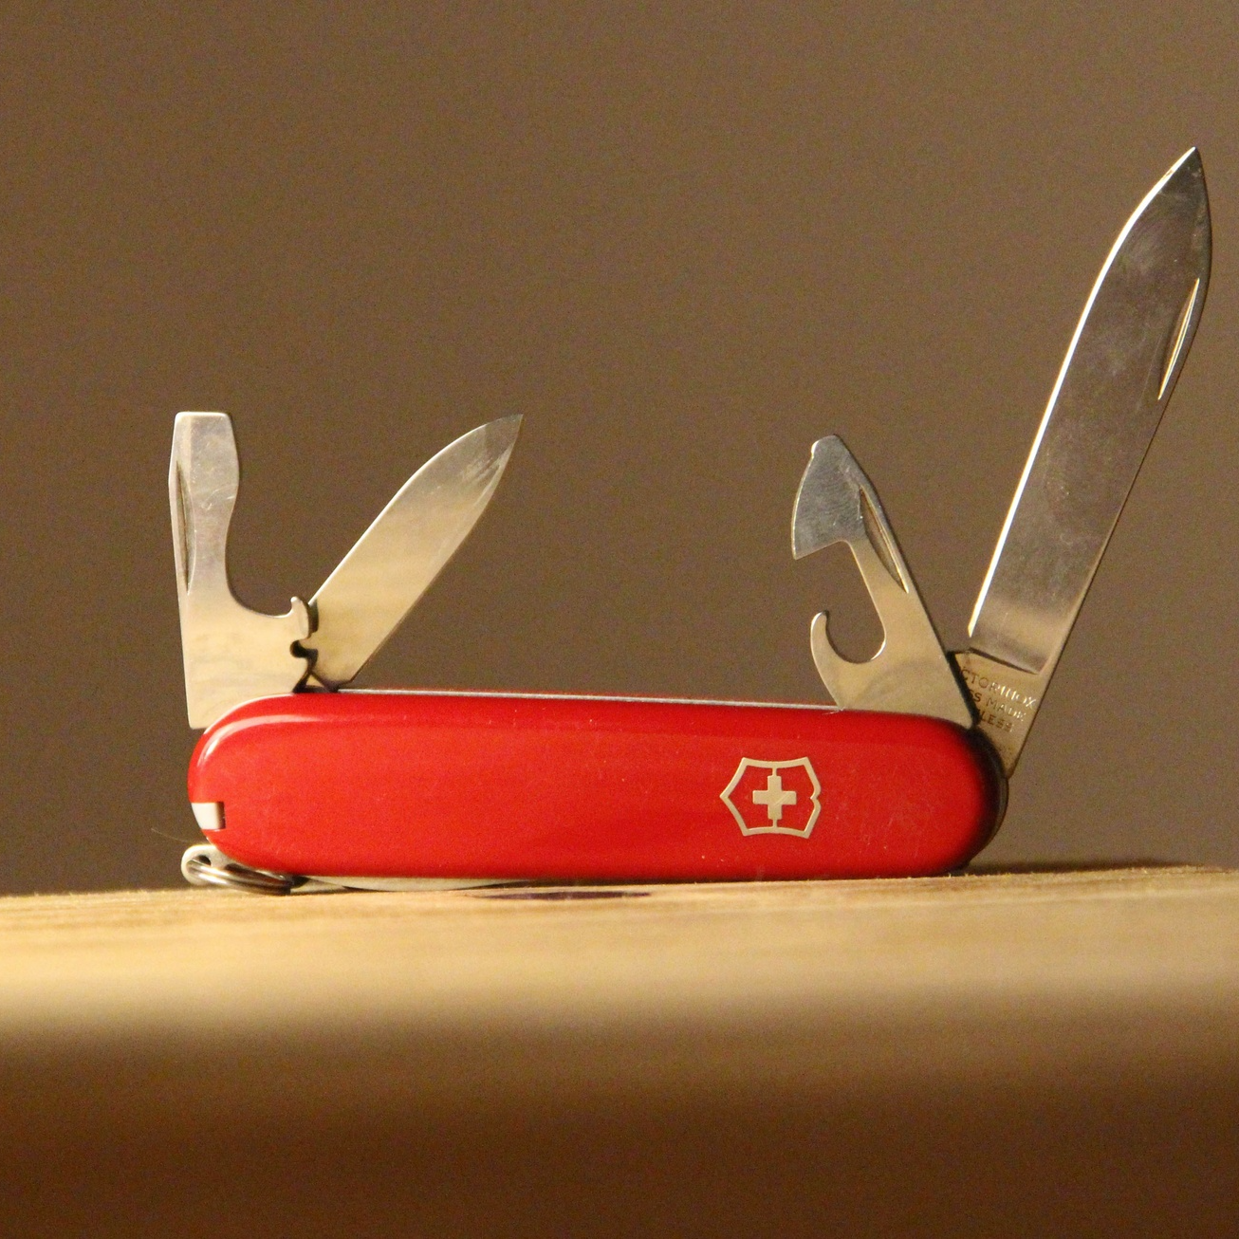
Practical Tips and Lessons Learned
What We’ve Learned Across Campaigns
Local storytelling works
Low-barrier offers get signups
Retargeting is essential
Clear goals = better results
Small budgets can succeed with focus

Slide 29
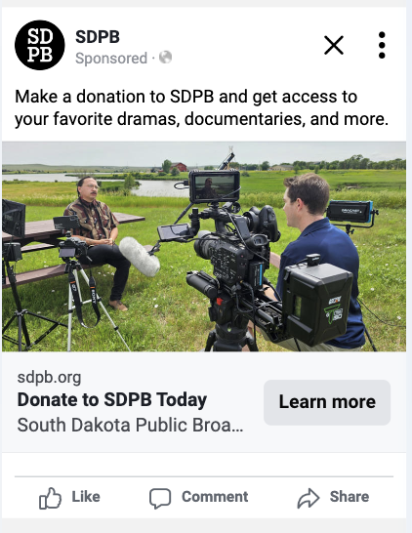
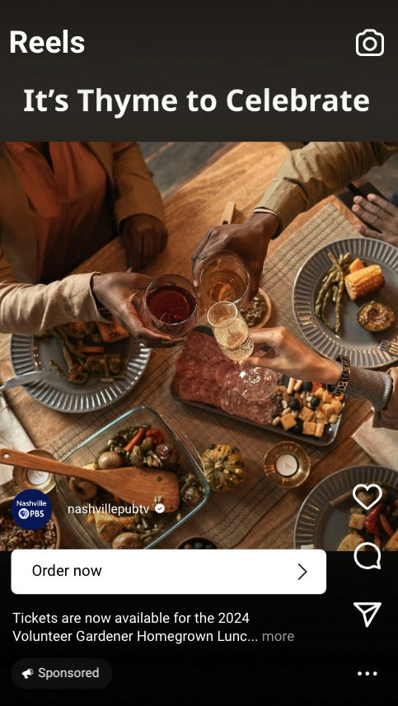
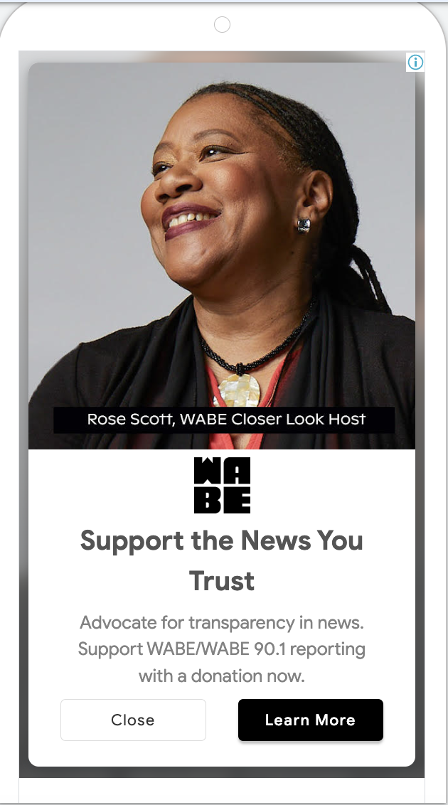
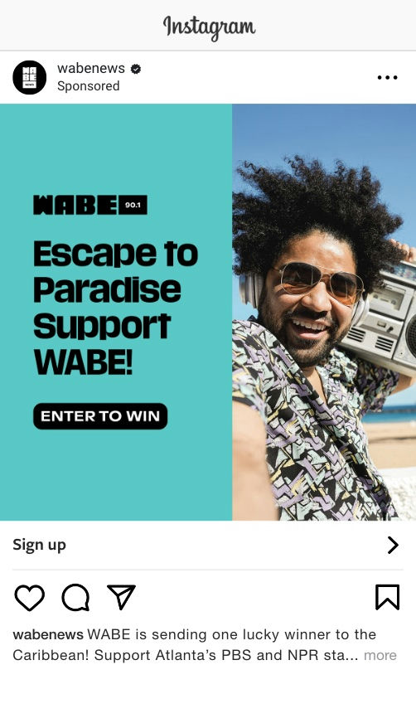
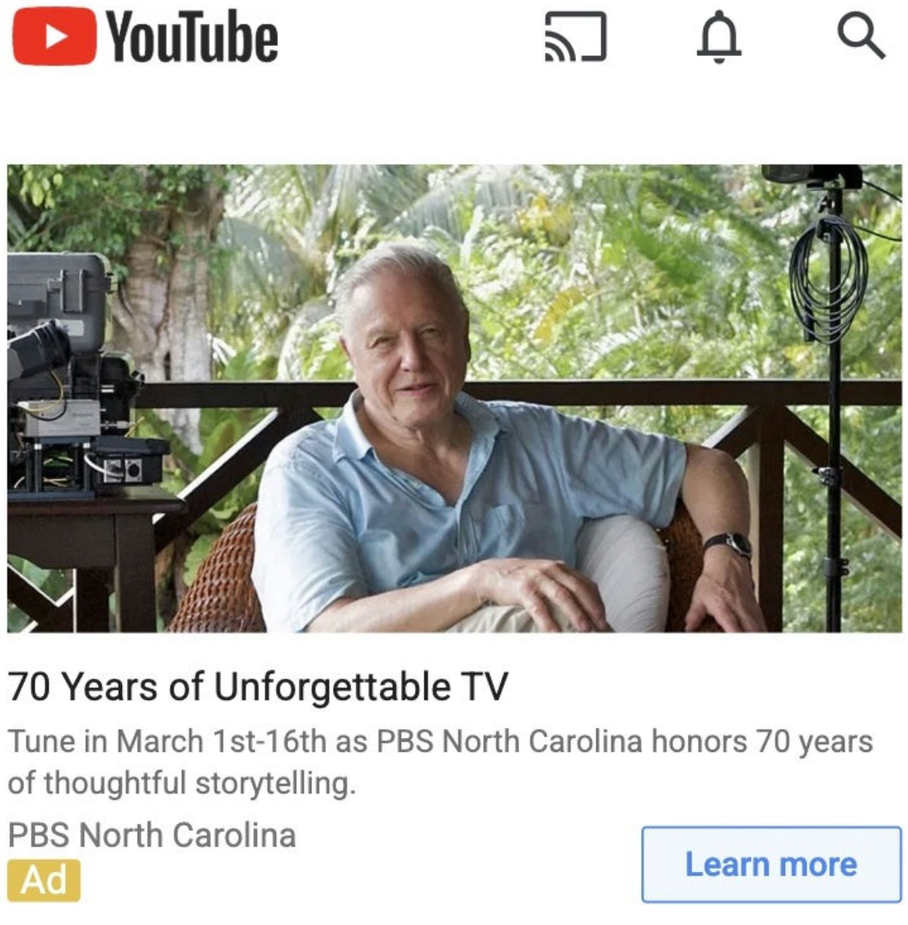
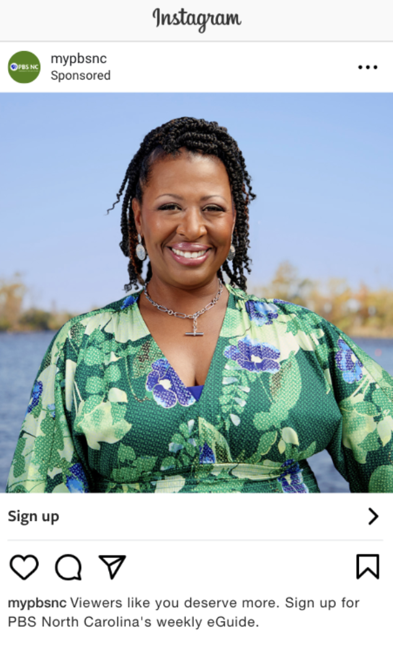
Real Local Campaigns in Action

Slide 30

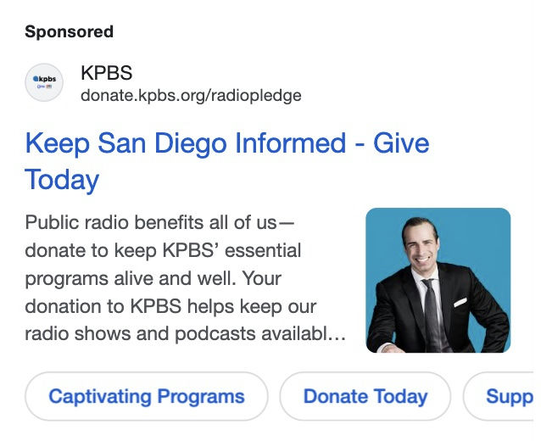
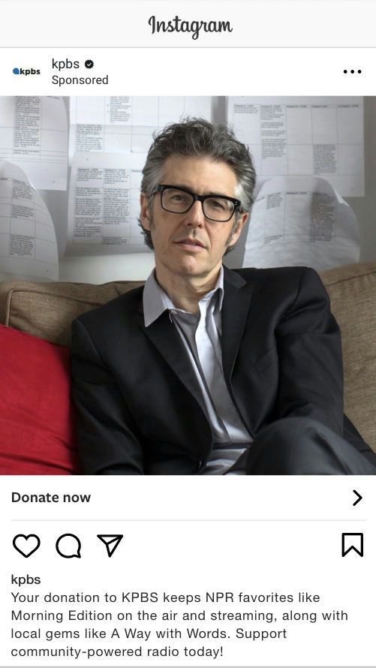


Small, well-targeted digital ads extended the pledge message beyond broadcast, turning on-air momentum into online giving.
KPBS Radio Pledge + Promo
$3,600 budget
Google + Meta ads
Result: ~250K impressions in market, 13.6K Google clicks (32.4% CTR), 223 Meta clicks

Slide 31
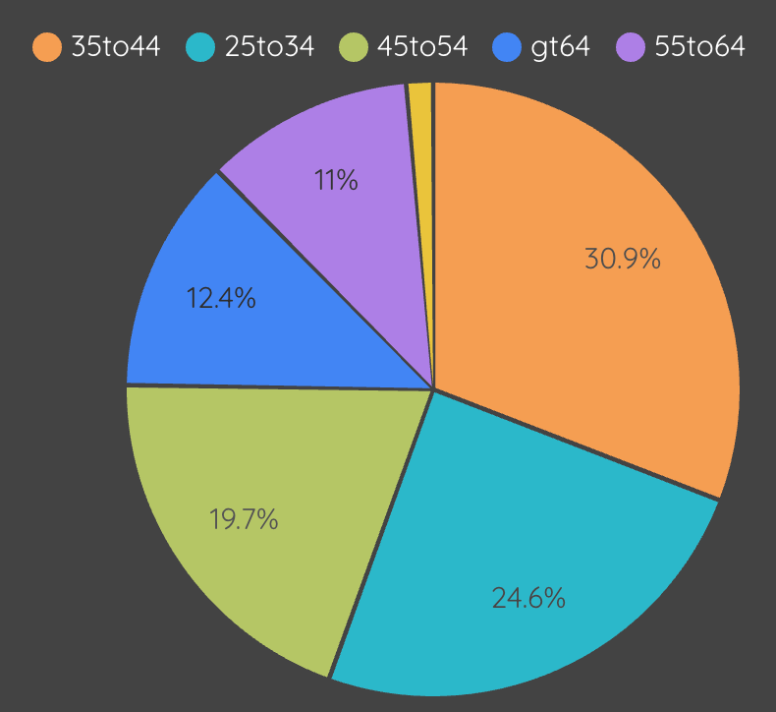

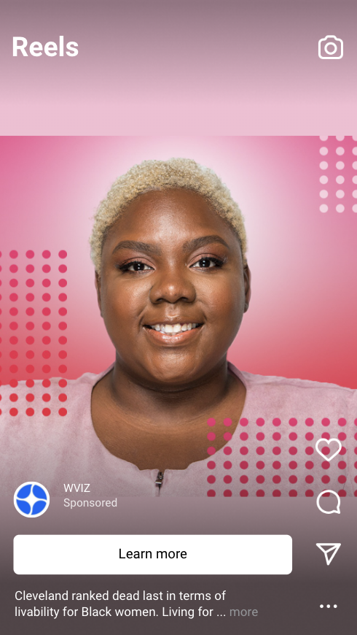
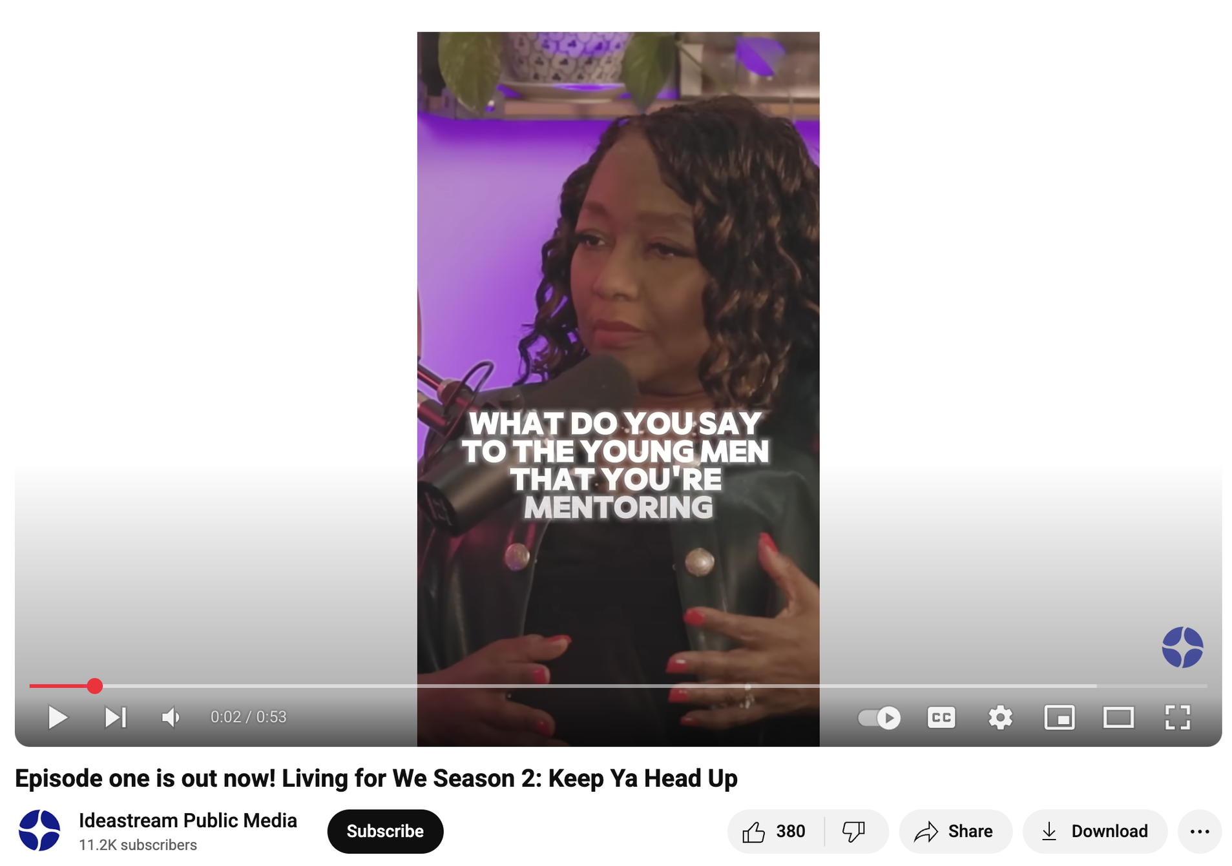
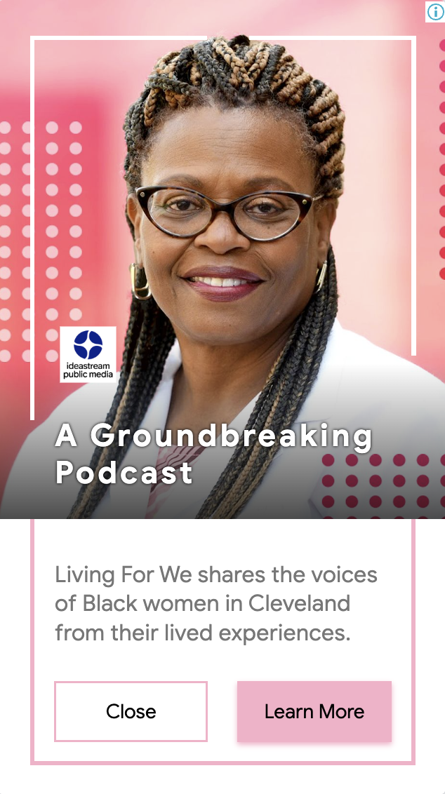
This modest campaign grew a loyal, younger podcast audience—building the pipeline for future members.
Ideastream Public Media
Living for We
$2,000 April-September 2025
Google Display, YouTube + Meta ads
Goals: Increase YT Subscribers, Engagement on YT channel, Increase Awareness of LFW Podcast
Result: ~175K impressions, 25K video views, 11K YouTube Subscribers

Slide 32
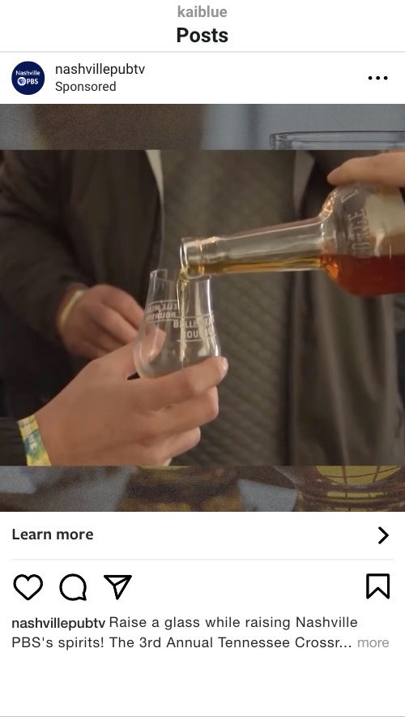
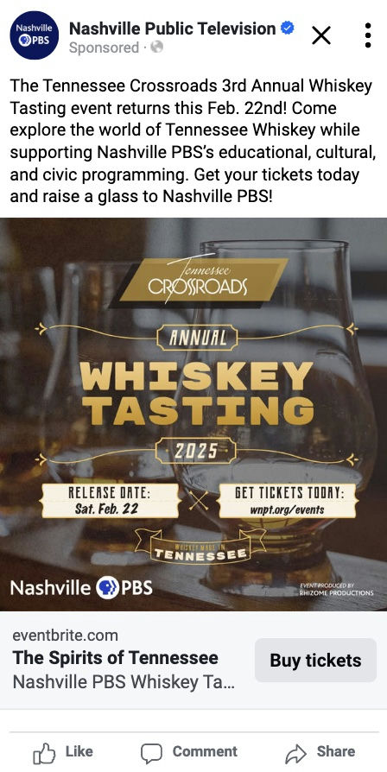
Targeted ads filled a local event fast—showing how small, agile digital tests can strengthen community support.
Nashville PBS
Whiskey Tasting
$2,000
Meta Ads Audience: Whiskey enthusiasts, Tennessee Crossroads viewers, and individuals who had engaged with Nashville PBS content before.
Goals: Ticket Sales (Event Sell-Out)

Slide 33
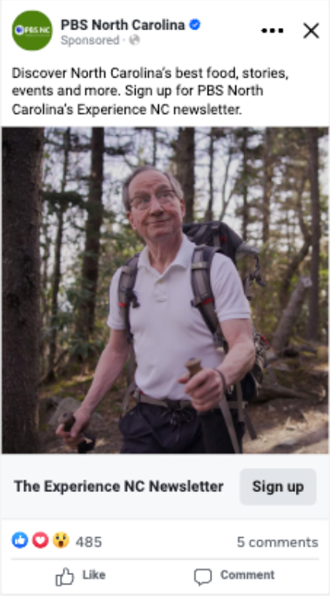
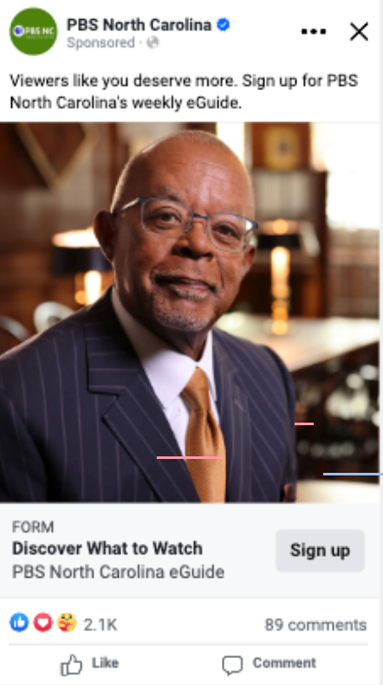
Small, ongoing digital efforts can grow engaged audiences year-round.
PBS North Carolina Lead Generation Campaign
Meta lead ads for PBS North Carolina’s E-Guide and Experience NC newsletters have generated 6,000+ new subscribers since July 2025, at less than $1 per lead.

Slide 34

Build Your Campaign Brief
What’s your local story?
What is your goal (awareness, leads, donations)?
What platform do you want to use?
What budget could you try?

Slide 35

The Case for Breaking the Rules

Slide 36
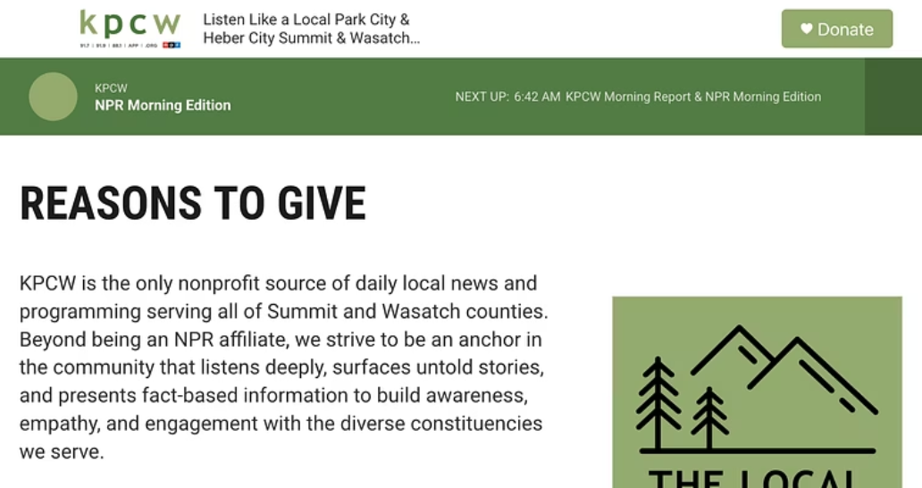
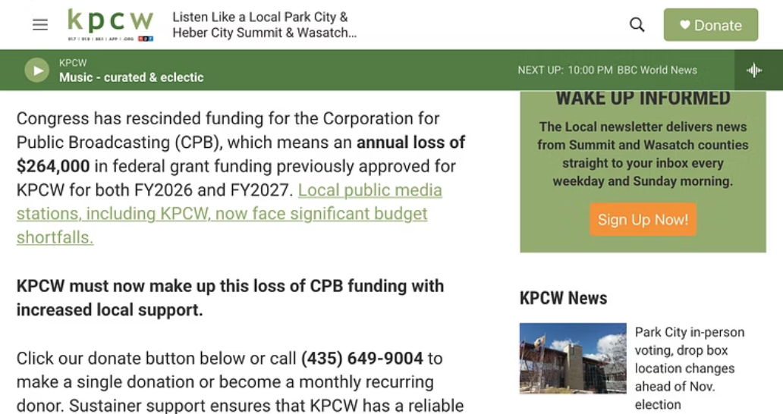
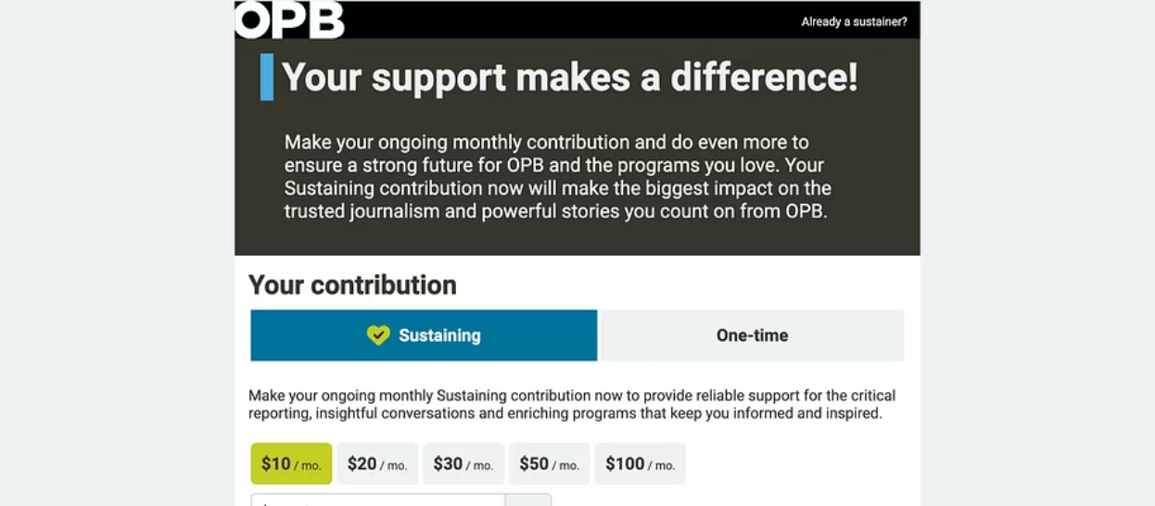
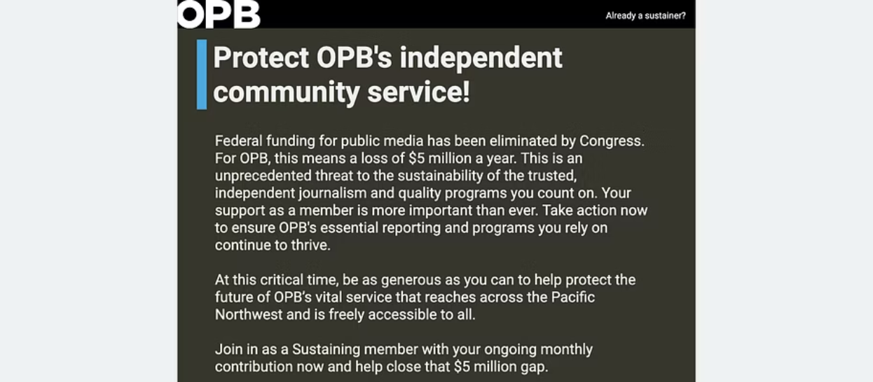

January 2025 → October 2025
No federal funding specifics → Fundraising on specifics
What happened? Public media broke its own rules.

Slide 37
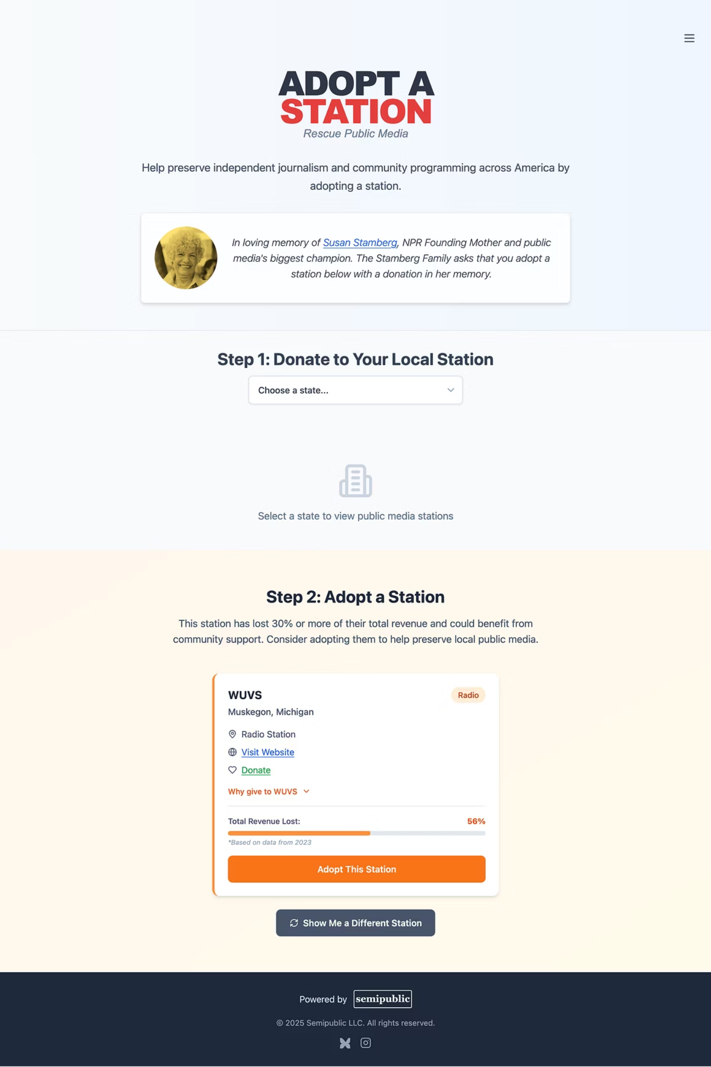

Opportunity: People wanted a central place to see which stations lost the most funding and donate
Broken Rule: No federal funding specifics
1
Revenue lost, pulled from my Substack dataset, is written as a percentage of total revenue and denoted by bar graph and color.
2
Broken Rule: Direct path to donation portal
Adopt A Station is an intermediary step.
3
Broken Rule: Hook→Pitch→Ask
"Adopting a public media station in need" is all three at once.
Broken Rule: Give as few choices for action as possible
4
Not only are there two initial action choices, but users that choose Step 1 are given 560+ choices, some with both a station URL and a donation portal.

Slide 38

First 30 Days Results:
37,000
16,000
~47%
unique visitors
outbound link clicks
CTR
50 states, 105 countries
to either station sites or donation portals
*if 1 visitor = 1 click
Radio Rescue (Oct 1-15) Campaign Results:
2,400
855
~36%
$7.50 / yr
unique visitors
outbound link clicks
CTR
Total investment
50 states, 26 countries
to either station sites or donation portals
domain name purchase. Bolt.new development, Supabase data hosting, and Netlify web hosting free.

Slide 39
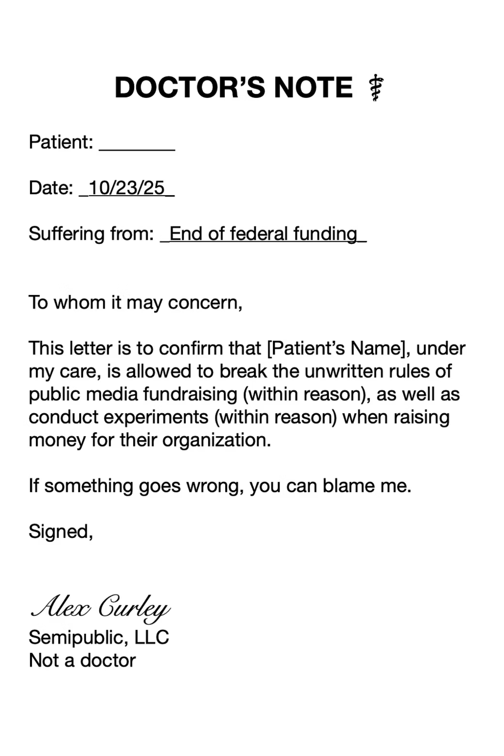
How to capture opportunity
1
Interrogate your data
What are people doing? What are they asking for? What data am I missing?
2
Identify gaps
Zoom out: What's the bigger context for what you found in your data? How can you cover that gap in a brand new way?
3
Scale risk
Use the amount of time and resources you have to scale how much risk you're willing to take. Then, add 30%.
4
Take chances, make mistakes, get messy
Channel your inner Ms. Frizzle.

Slide 40
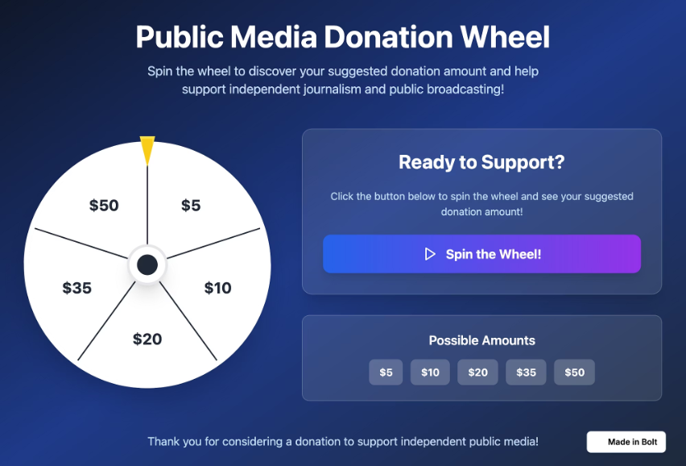
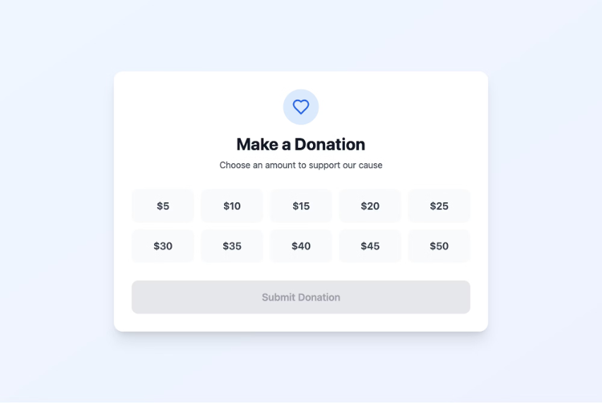
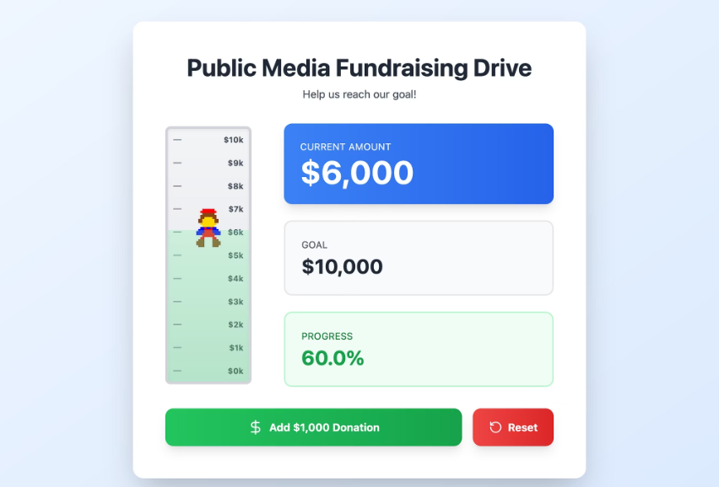
Inspiration
All of these made in less than 15 minutes in Bolt.new
semipublicdemo1.bolt.host
semipublicdemo2.bolt.host
semipublicdemo3.bolt.host
Spin the wheel to have a donation amount suggested for you!
Make the lamp behind me turn on and off by submitting a donation. Yes, right now!
Make not-Mario climb the donation tracker!
Take it to local events, embed it on website, etc. *Not quite functional, but for 15 mins of work you get the idea.
Allow people to see their donations get added to the total in real time. Organize events around specific milestones. Reset the counter for every hourly goal.
Make your fund drives interactive: Show first names of donors on a video stream, change the studio light colors, play a silly sound, etc.

