Slide 1

Uncertainty’s Surprising Wisdom: An Exploration
Learning to Harness Uncertainty
In an Age of Flux

Slide 2
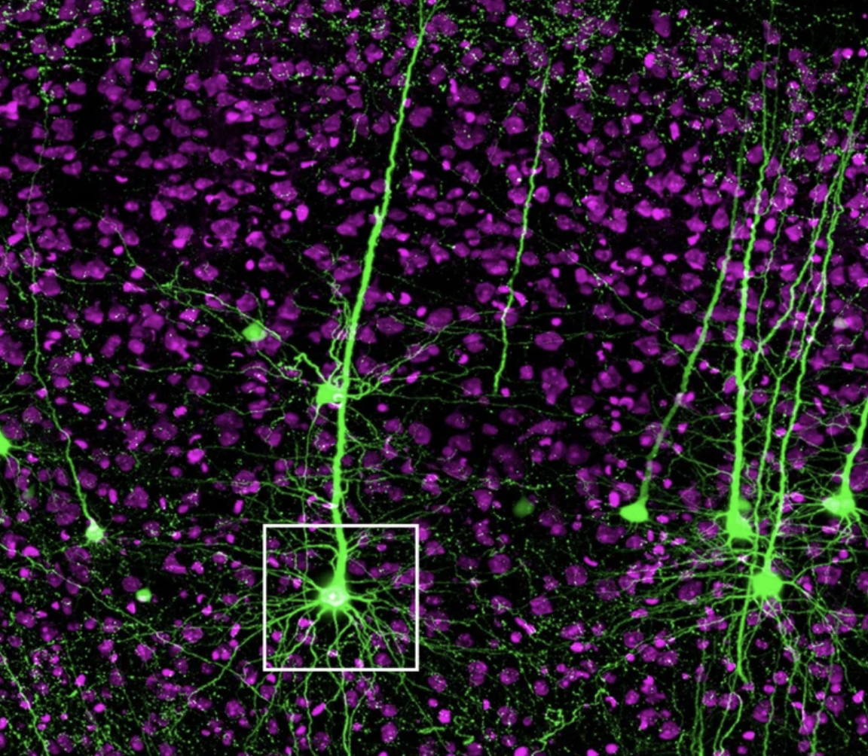
Pyramidal Neurons – Jiang et al, Scientific Reports, 2020

Slide 3
“Uncertainty is the brain telling itself, ‘there’s something to be learned here’.”
- Joseph Kable, neuroscientist

Slide 4
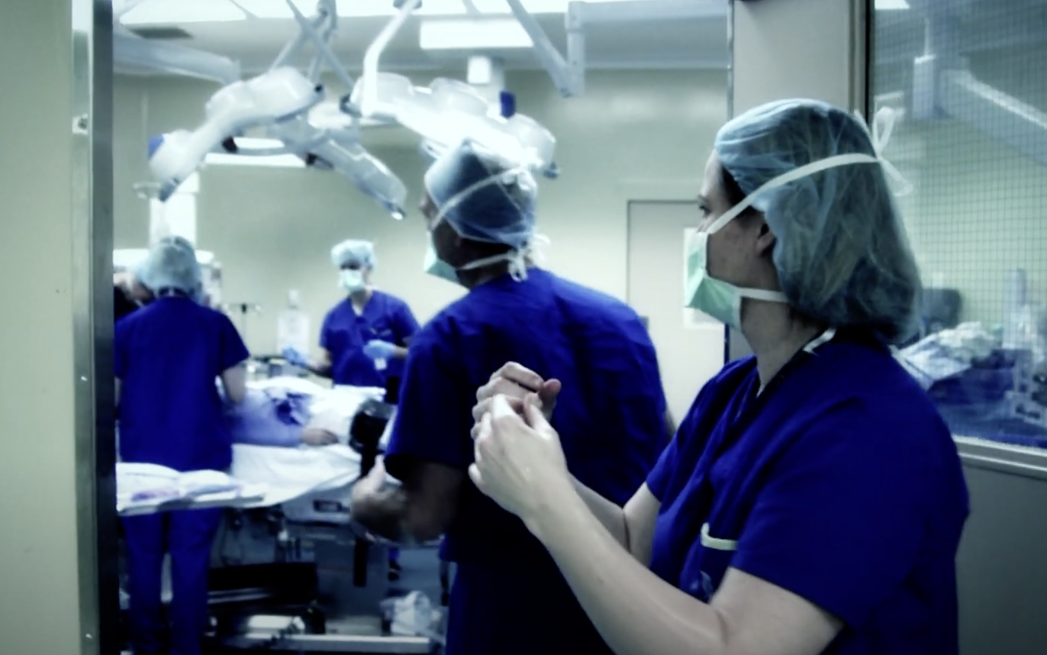

Carol-anne Moulton, MD, PhD, University of Toronto

Slide 5
ROUTINE EXPERTISE
ADAPTIVE EXPERTISE
Little to No Exploration of New Problem
Falls into Trap of Carryover Mode
Quick, Sureness is their Badge of Honor
*
Complacently Sticks to Comfort Zone
Inhabits the Question When Faced with the New
Widens and Deepens Frame of Understanding
Listens to the Stories the Problem Wants to Tell
*
Takes on Harder Challenges, Welcomes Errors

Slide 6
“When you’re uncertain, that’s when you care.”
- Carol-anne Moulton, surgeon

Slide 7
NASA Rover Perseverance Landing on Mars 2021

Slide 8

Full Circle Expedition, 2022 / Evan Green

Slide 9
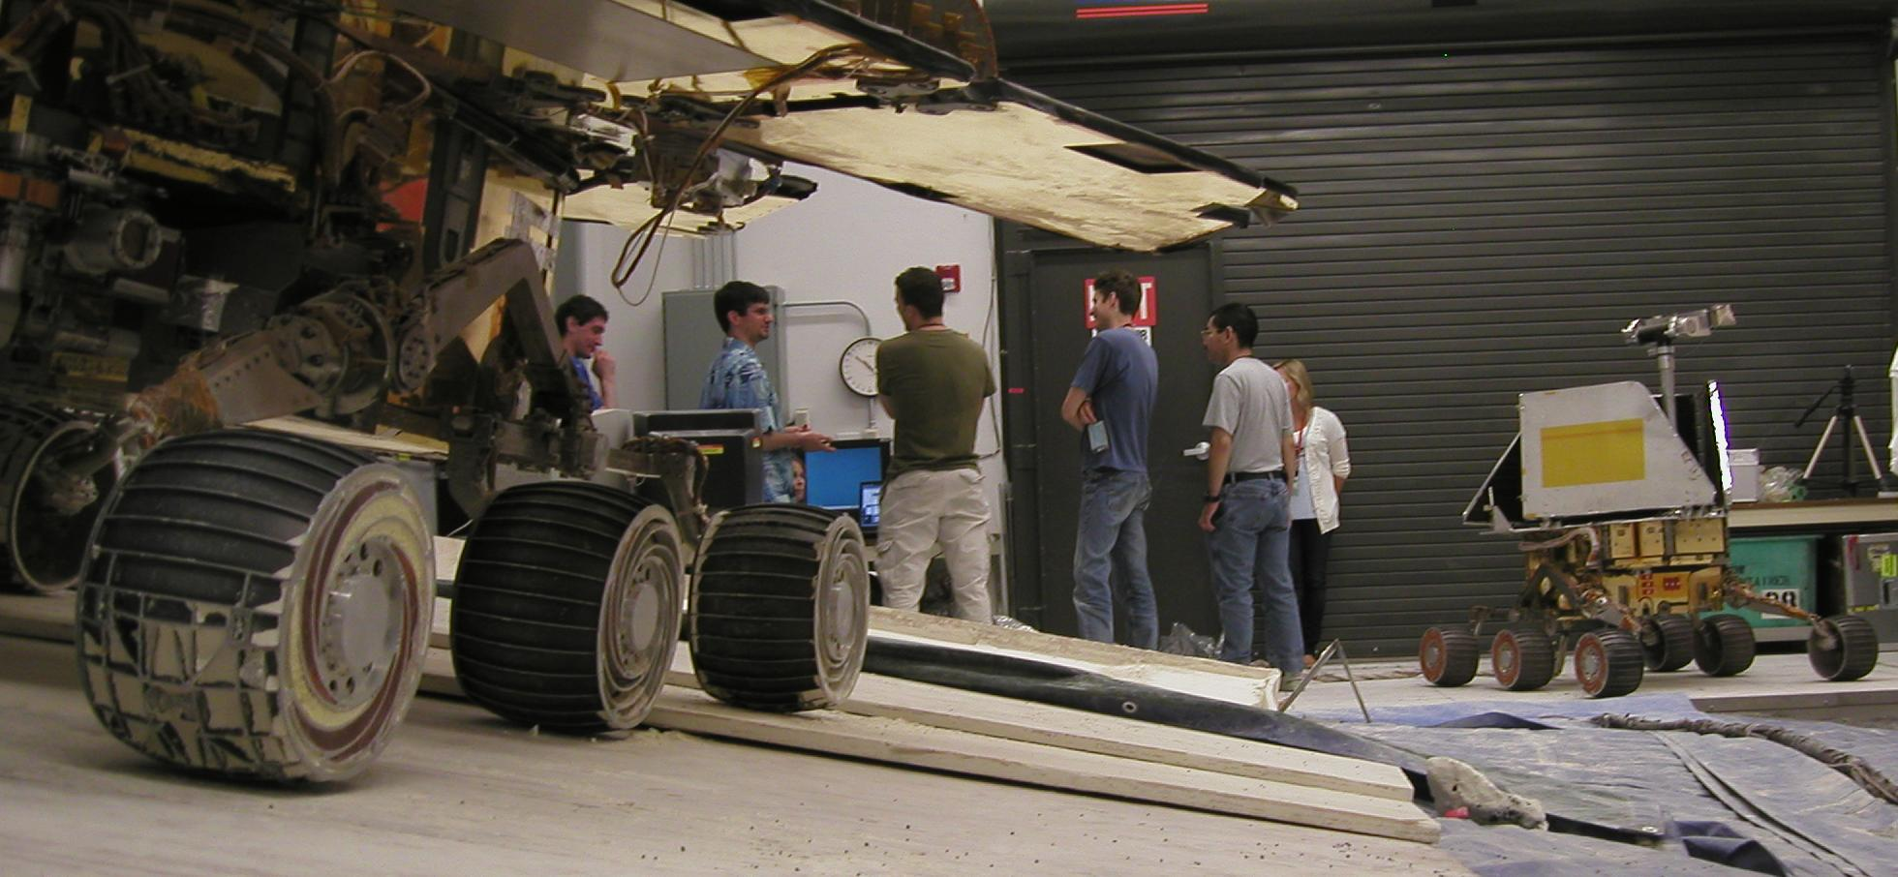

Slide 10
Uncertainty’s Surprising Wisdom: An Exploration
Volatility
Unpredictability
Precarity…
How will we respond?

Slide 11

Photo: Melinda Green

Slide 12
Recap
Welcome the Good Stress of Uncertainty.
Dial down Outcome Fixation.
When the Problem is New or Murky, Inhabit the Question.
Widen and Deepen Your Sense of the Problem.
Consider the opposite.
To get better at what you do, try not-knowing!
Be open to discord and dissent.
Practice ‘Maybe Power’ and the ‘Listening Ritual.’

Slide 13
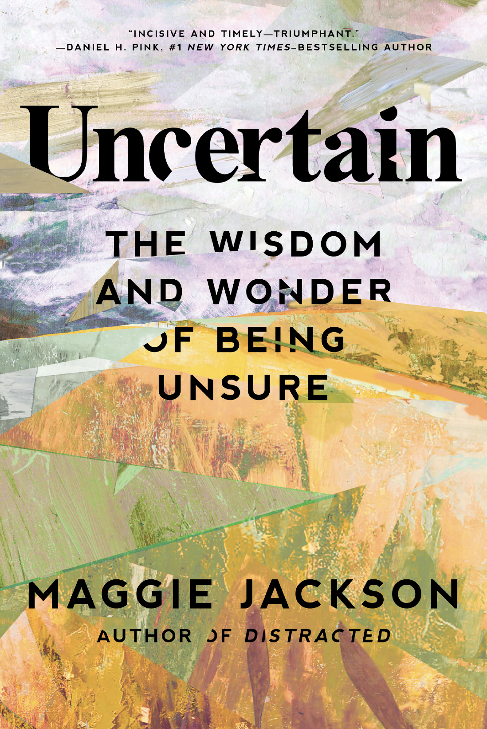
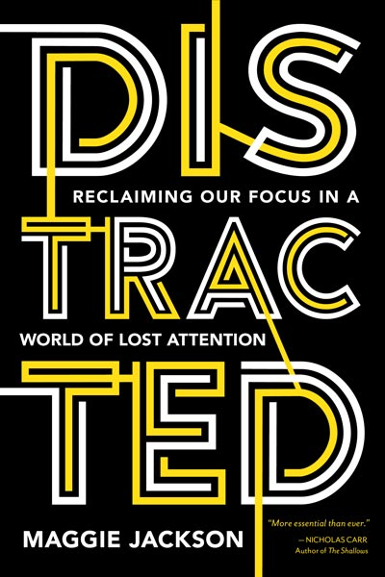
maggie-jackson.com
maggie@maggie-jackson.com

